Slide 1
TB 2018
Political support for TB from other sectors
Yogan Pillay, South Africa
IAS, pre-conference, July 2018

Slide 2
Presentation outline
Why is support from other sectors important?
How to generate support?
South African experiences
Concluding notes

Slide 3
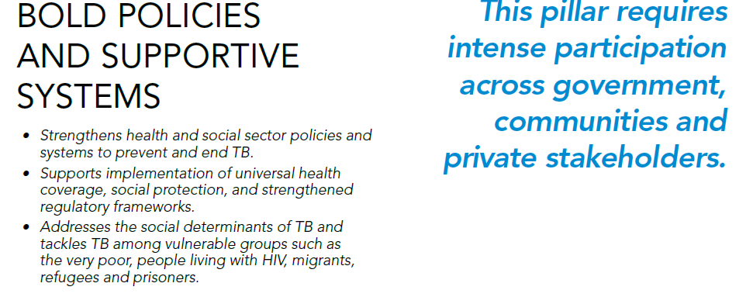

Slide 4
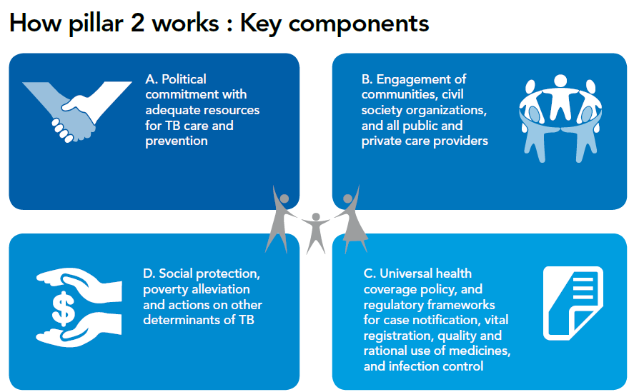
End TB Strategy: pillar 2

Slide 5
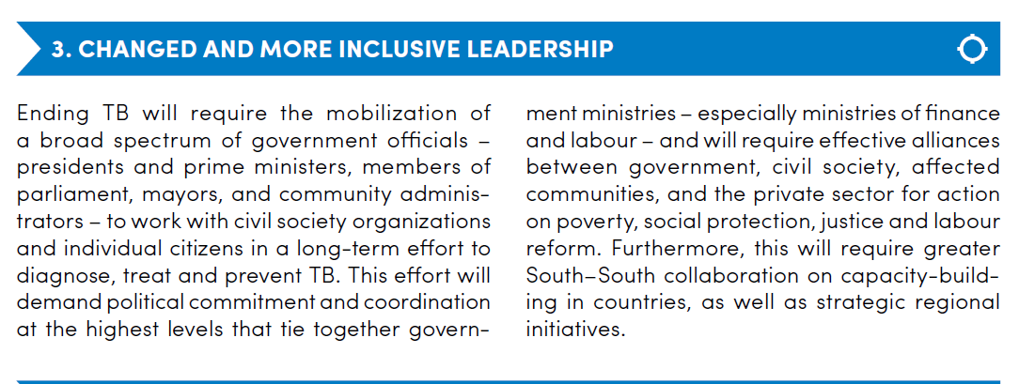
A paradigm shift in the fight against TB (Stop TB Partnership)

Slide 6
How to generate support: Global TB Caucus
The Global TB Caucus network of parliamentarians from more than 130 countries.
The members of the Caucus work collectively and individually to end the TB epidemic.
Members of the Caucus use the following principles outlined in the founding document, the Barcelona Declaration, in their advocacy work:
Work across geographical and political divides in a non-partisan and inclusive fashion;
Engage with civil society and all other stakeholders involved in the fight against the TB epidemic; and
Confront stigma and social isolation associated with the disease.

Slide 7
South African experiences
National Development Plan 2012:
“Improve human security … especially when it comes to water and energy – and knowledge-sharing on vital issues such as communicable diseases, most notably HIV/AIDS, malaria and tuberculosis…”

Slide 8
South African experiences
South African National AIDS Council
Despite its name, includes TB and STIs
Comprised of 19 sectors, government being one sector
Active civil society both in and outside SANAC
Inter-ministerial Committee (HIV, TB)
National Strategic Plan for HIV, TB and STIs, 2017-2022
Conditional grant for HIV expanded in 2016 to include TB (after investment case presented to Treasury)

Slide 9
Minister Motsoaledi: TB champion
We have an activist Minister of Health
Champions TB locally and globally
Chair of Stop TB Board
Co-Chair of the Global TB Caucus
Motivated for HLM for TB (September 2018)
Motivated in BRICS for Heads of States to attend and commit to implementation of the Political Declaration
Need to ensure that our Embassies in NYC work hard to get a really good political declaration

Slide 10
Concluding notes
Strategies are clear: WHO and Stop TB Partnership
We can get political commitment but we must use every opportunity to make the case for the end of TB as a public health threat
We need to mobilise all politicians to ensure that TB gets the budget it needs at local and global levels
Need to work closely with diplomats in NYC to get the best possible political declaration in September
Lets not ‘waste’ the opportunity presented by the HLM on TB!
THANK YOU!

